Slide 1





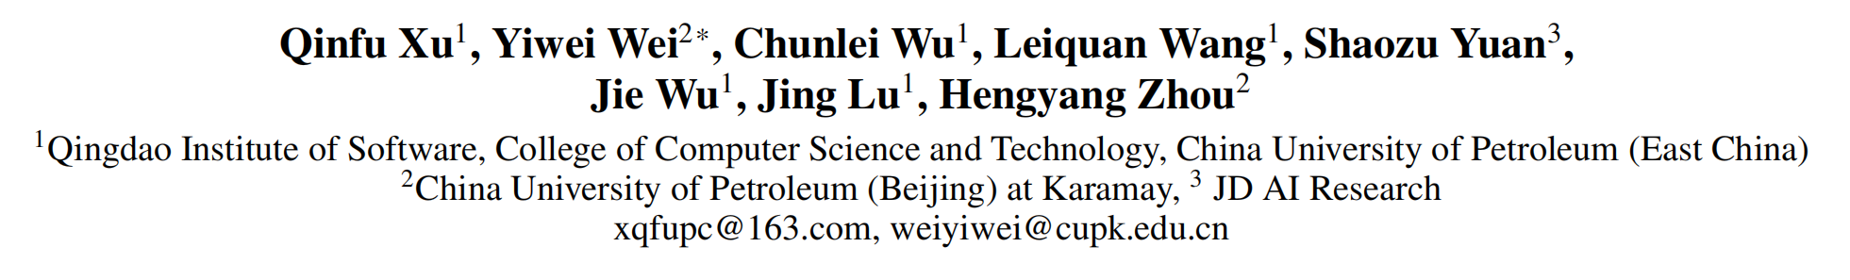





ATAI
Advanced Techniqueof Artificial Intelligence
ATAI
ChongqingUniversity _{AdvancedTechniqueof}
of Technology Artificial Intelligence
Chongqing University of
Technology
Chongqing University ^{ATAI}
_{of Technology} Advanced Techniqueof
Artificial Intelligence
Chongqing University of Technology
Chongqing University of Technology
Towards Multimodal Sentiment Analysis via Hierarchical
CorrelationModeling with Semantic Distribution Constraints
Code:none
2025.5.8 •ChongQing
—— AAAI 2025
Reported by YaoChen Li
1

Slide 2

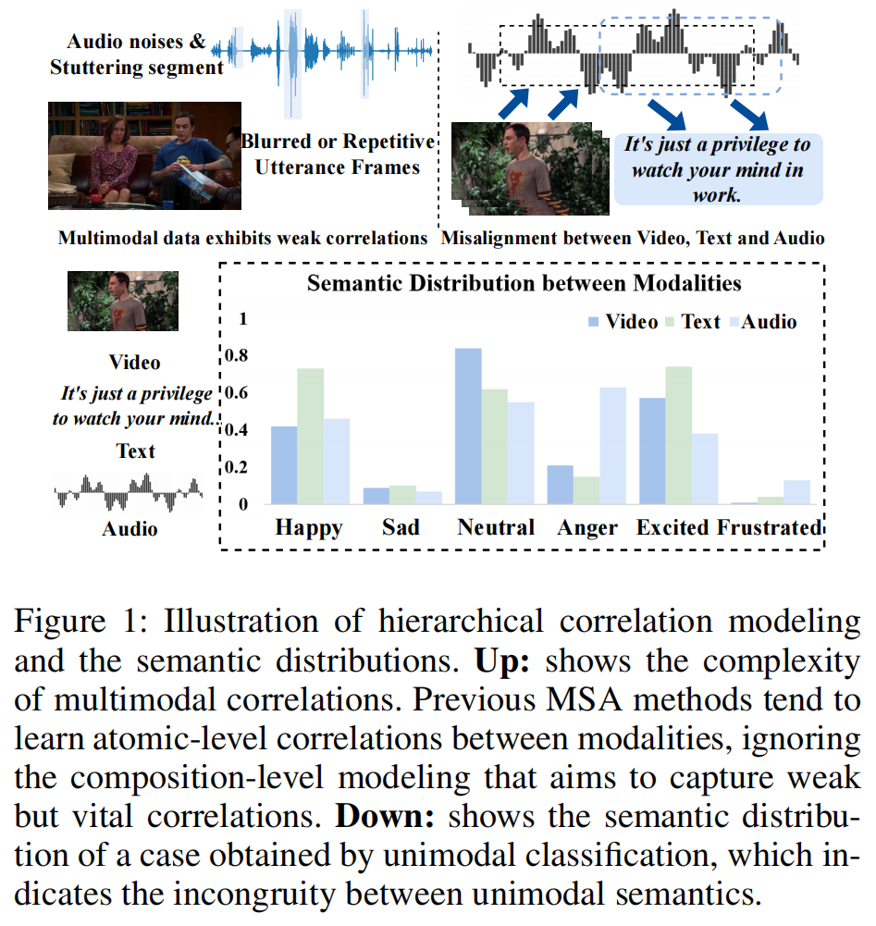
ATAI
AdvancedTechniqueof
Artificial Intelligence
ATAI
ChongqingUniversity _{AdvancedTechniqueof}
of Technology Artificial Intelligence
ChongqingUniversity of Technology
Motivation
1)Most existing techniques only learn the atomic-level features that reflect strong correlations, while ignoring more complex compositions in multimodal data.
2)Previous works overlooked the inconsistent semantic distributions among different modalities.

Slide 3

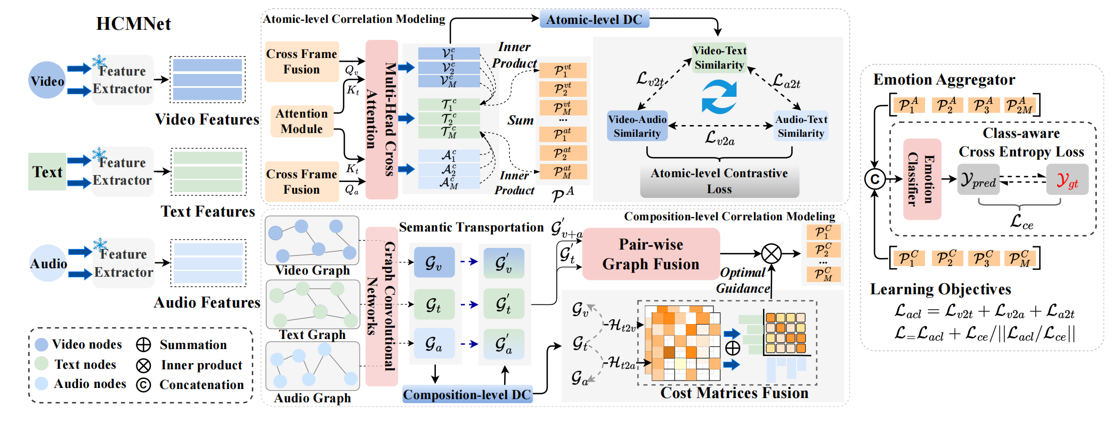
ChongqingUniversity of Technology
ATAI
AdvancedTechniqueof
Artificial Intelligence
ATAI
ChongqingUniversity _{AdvancedTechniqueof}
of Technology Artificial Intelligence
Overview

Slide 4

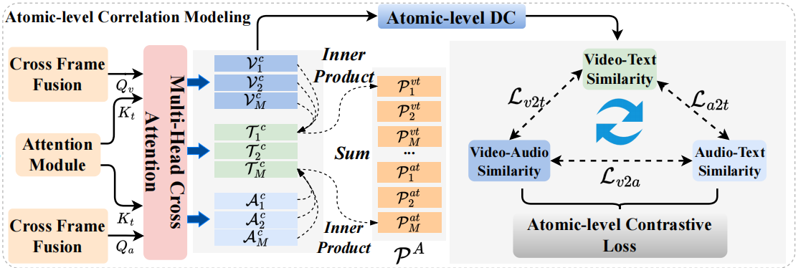
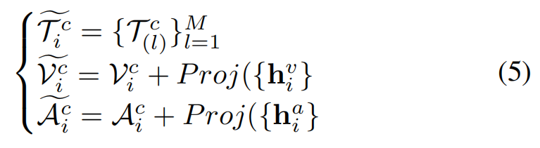
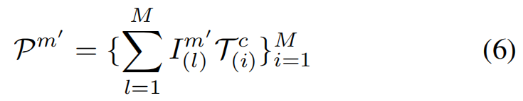


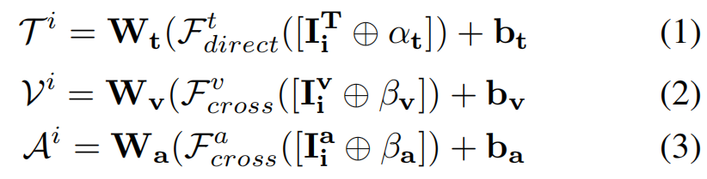


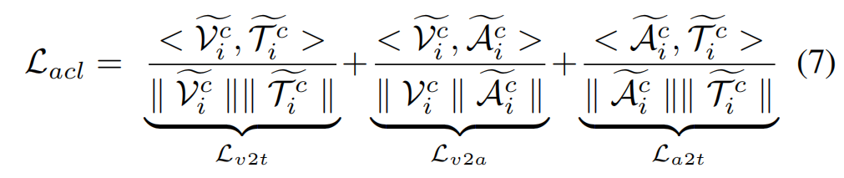
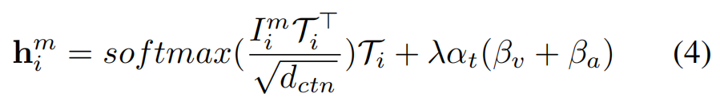
ChongqingUniversity of Technology
ATAI
AdvancedTechniqueof
Artificial Intelligence
ATAI
ChongqingUniversity _{AdvancedTechniqueof}
of Technology Artificial Intelligence
Method

Slide 5
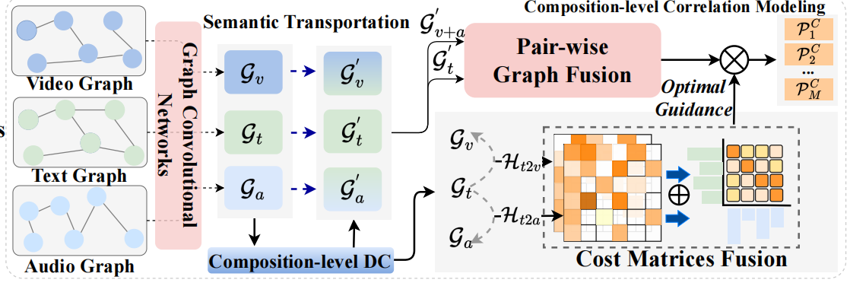
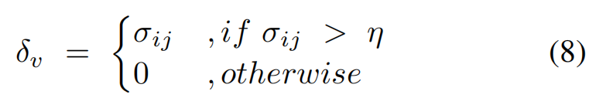

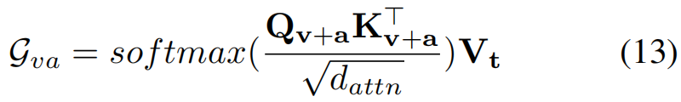
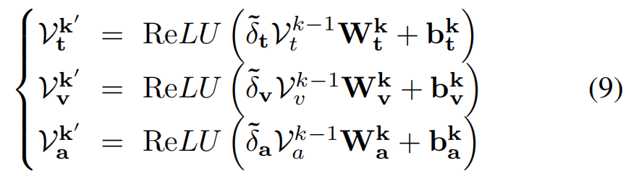


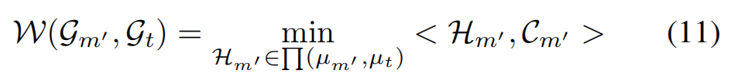


ChongqingUniversity of Technology
ATAI
AdvancedTechniqueof
Artificial Intelligence
ATAI
ChongqingUniversity _{AdvancedTechniqueof}
of Technology Artificial Intelligence
Method

Slide 6
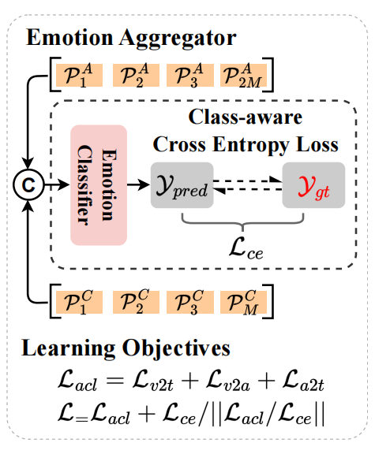
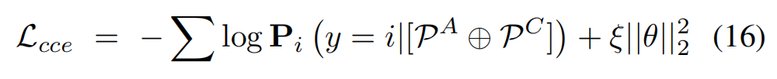

ChongqingUniversity of Technology
ATAI
AdvancedTechniqueof
Artificial Intelligence
ATAI
ChongqingUniversity _{AdvancedTechniqueof}
of Technology Artificial Intelligence
Method

Slide 7

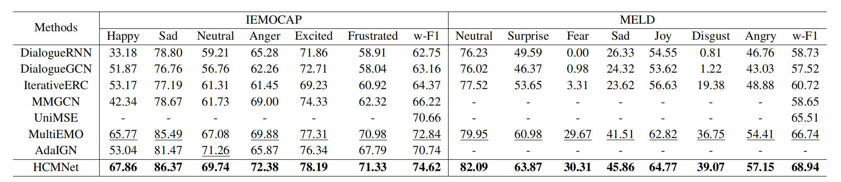
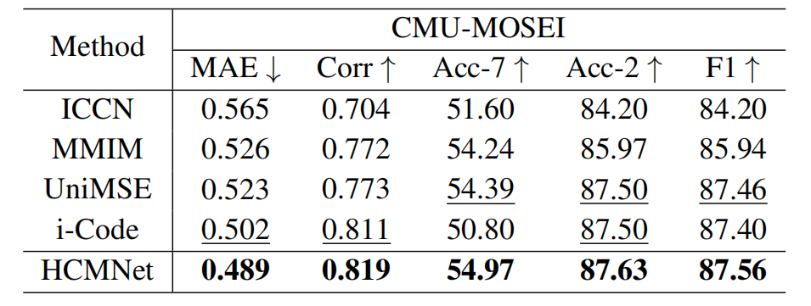
ATAI
AdvancedTechniqueof
Artificial Intelligence
ATAI
ChongqingUniversity _{AdvancedTechniqueof}
of Technology Artificial Intelligence
ChongqingUniversity of Technology
Experiments

Slide 8
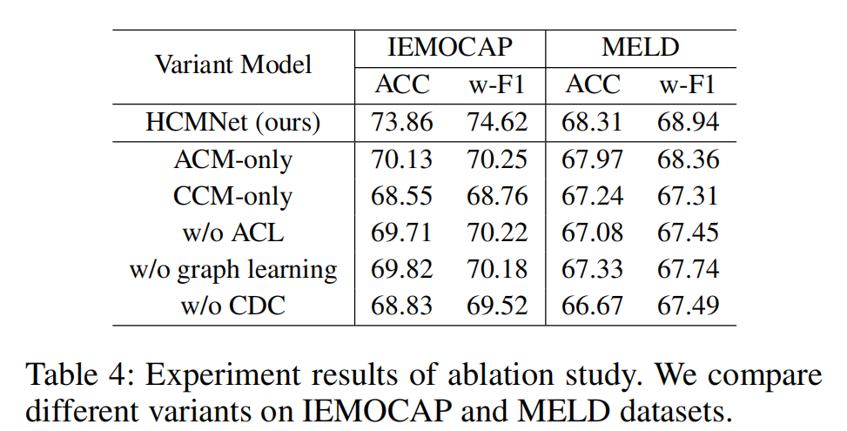
ATAI
AdvancedTechniqueof
Artificial Intelligence
ATAI
ChongqingUniversity _{AdvancedTechniqueof}
of Technology Artificial Intelligence
ChongqingUniversity of Technology
Experiments

Slide 9
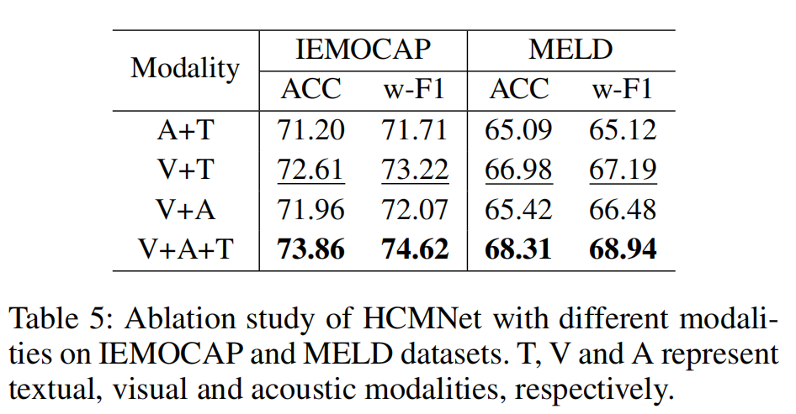
ChongqingUniversity of Technology
ATAI
AdvancedTechniqueof
Artificial Intelligence
ATAI
ChongqingUniversity _{AdvancedTechniqueof}
of Technology Artificial Intelligence
Experiments

Slide 10
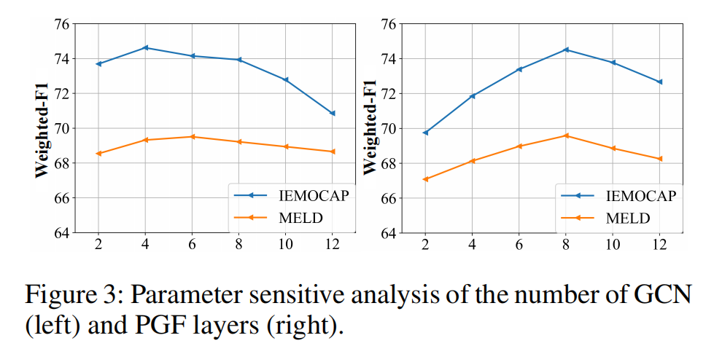
ChongqingUniversity of Technology
ATAI
AdvancedTechniqueof
Artificial Intelligence
ATAI
ChongqingUniversity _{AdvancedTechniqueof}
of Technology Artificial Intelligence
Experiments

Slide 11
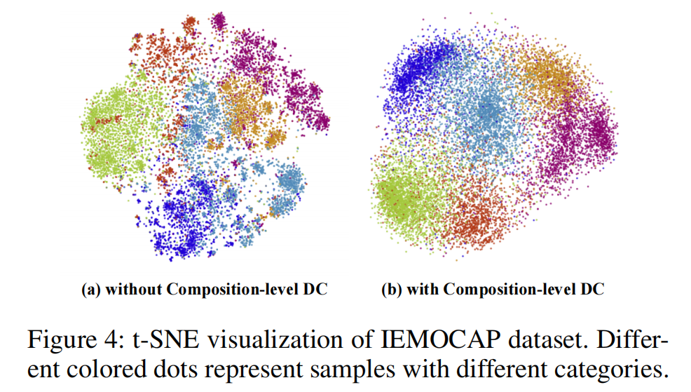
ChongqingUniversity of Technology
ATAI
AdvancedTechniqueof
Artificial Intelligence
ATAI
ChongqingUniversity _{AdvancedTechniqueof}
of Technology Artificial Intelligence
Experiments

Slide 12
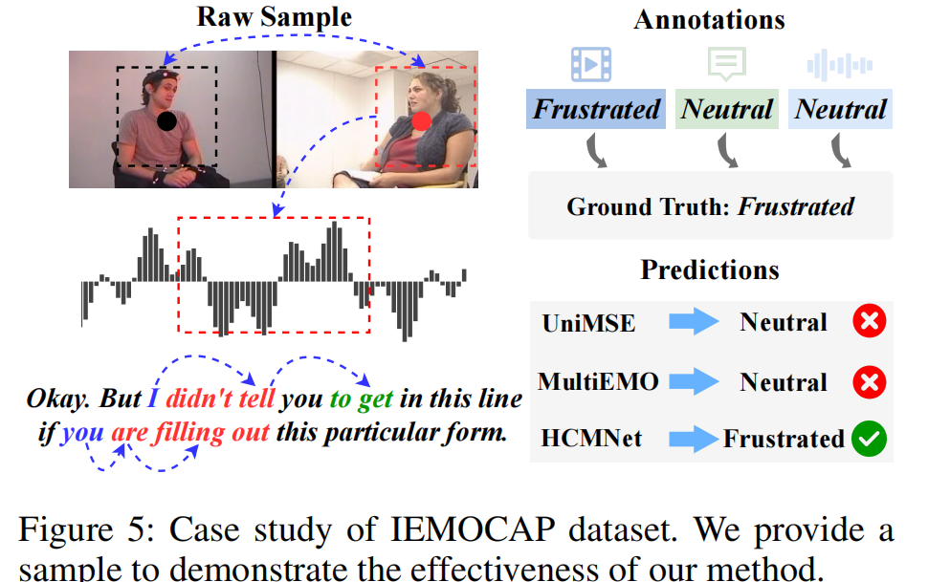
ChongqingUniversity of Technology
ATAI
AdvancedTechniqueof
Artificial Intelligence
ATAI
ChongqingUniversity _{AdvancedTechniqueof}
of Technology Artificial Intelligence
Experiments

Slide 13


ChongqingUniversity of Technology
ATAI
AdvancedTechniqueof
Artificial Intelligence
ATAI
ChongqingUniversity _{AdvancedTechniqueof}
of Technology Artificial Intelligence
Thanks!

